Slide 1



052_HCM_UIT_04_NET
AB-SD
Group 01
Tran Dieu Nhat Hanh
Nguyen Trung Nguyen
Nguyen Tran Thinh
Nguyen Thi Tinh

Slide 2

Content
Requirement
SRS
Q&A
Design
Use case
Screen
Sequence Diagram
Database Schema
Coding
Testing
Unit test
Summary

Slide 3
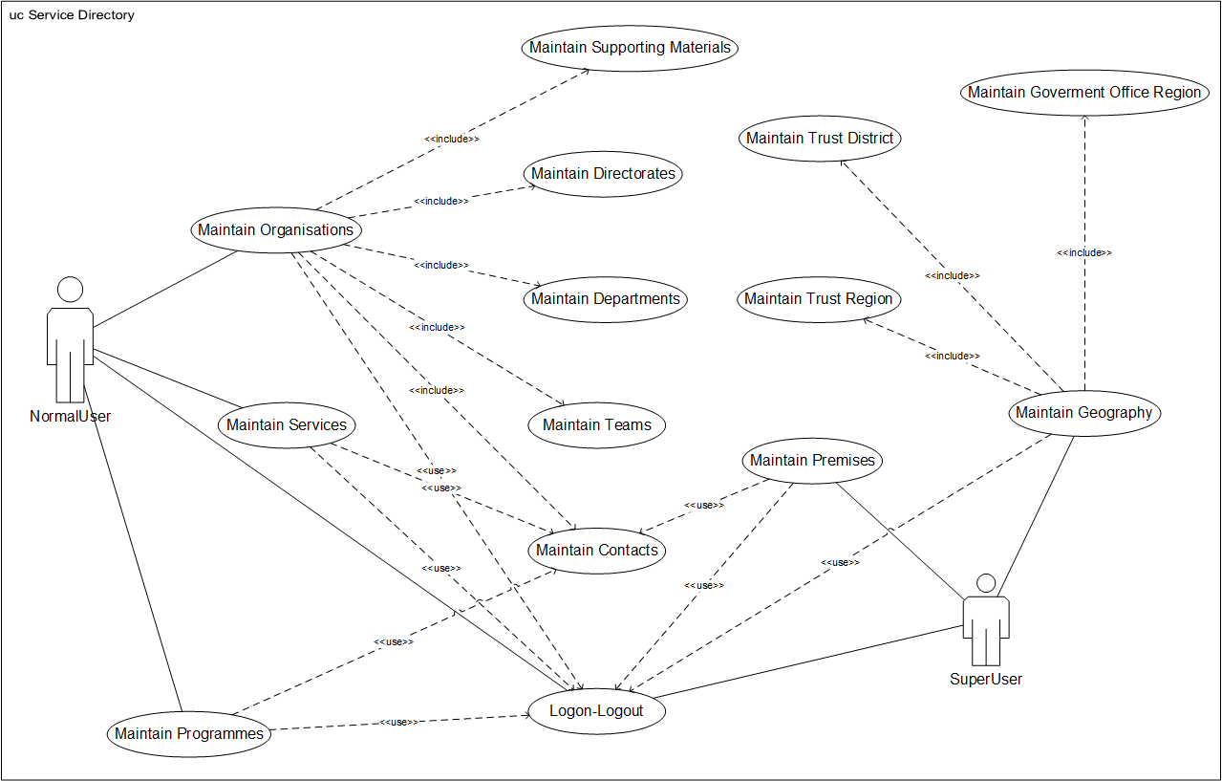
1. Requirement

Slide 4
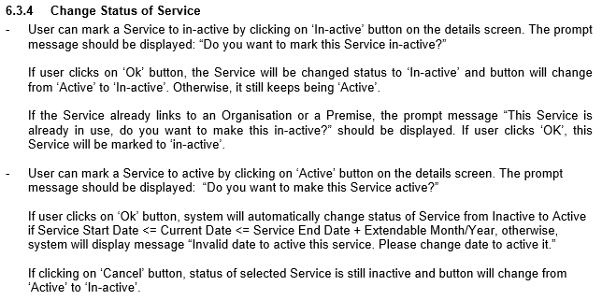
1. Requirement
SRS: ( requirement\[HanhTDN] AB-SD_Software Requirements Specification.docx )
Usecase 3: Maintain Services:
List Services
Add Service
Amend Service
Change Status of Service

Slide 5
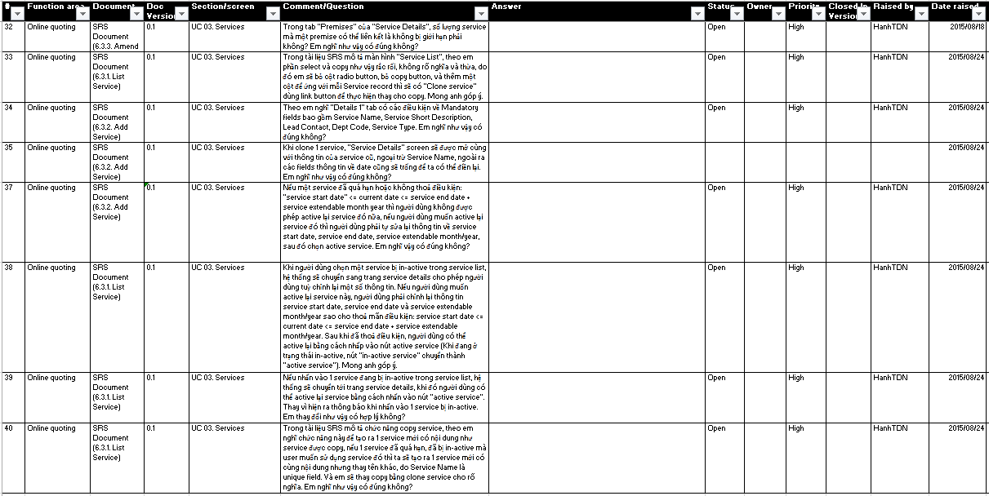
1. Requirement
Q&A: ( q&a\hanhtdn.se@gmail.com - AB-SD - Q&AList.xls )

Slide 6
2. Design
Usecase: ( design\hanhtdn.se@gmail.com - AB-SD - UseCase.xls )

Slide 7
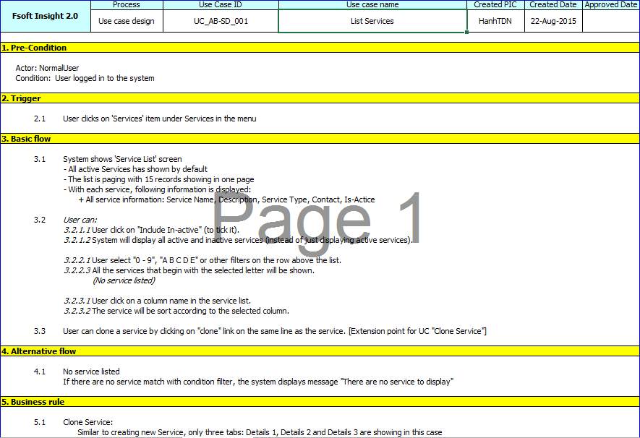
2. Design
Usecase UC_AB-SD_001. List Services
Screen

Slide 8
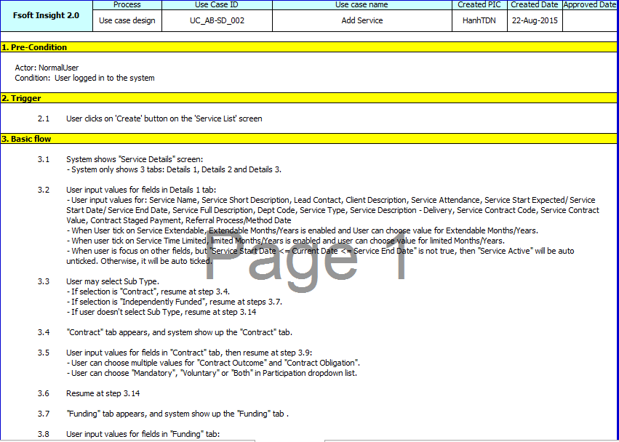
2. Design
Usecase UC_AB-SD_002. Add Service
Screen

Slide 9
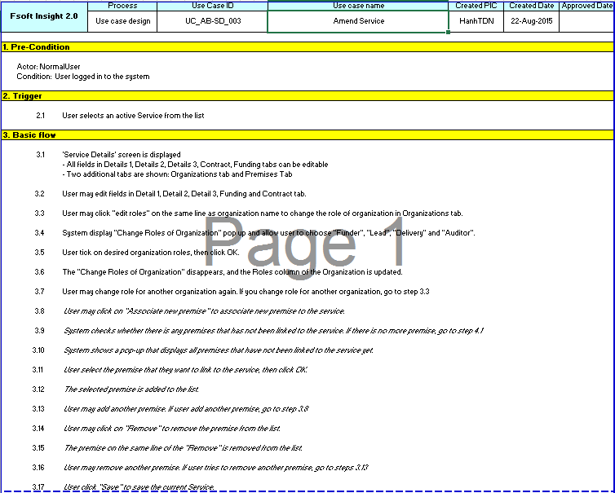
2. Design
Usecase UC_AB-SD_003. Amend Service

Slide 10
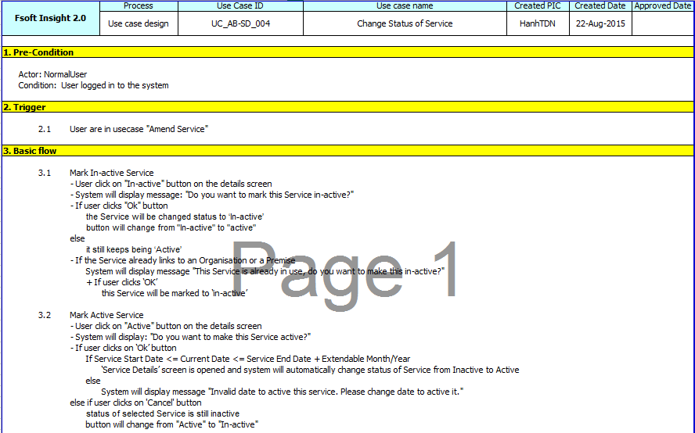
2. Design
Usecase UC_AB-SD_004. Change Status of Service
Screen

Slide 11
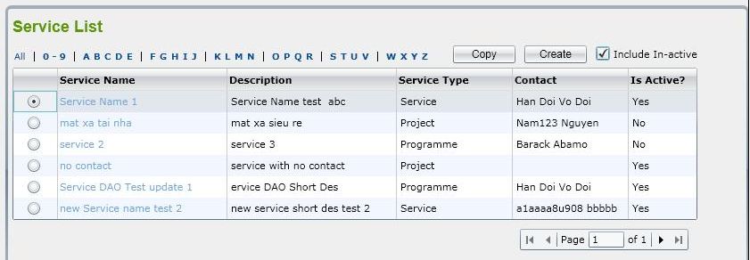
2. Design
Screen
return

Slide 12
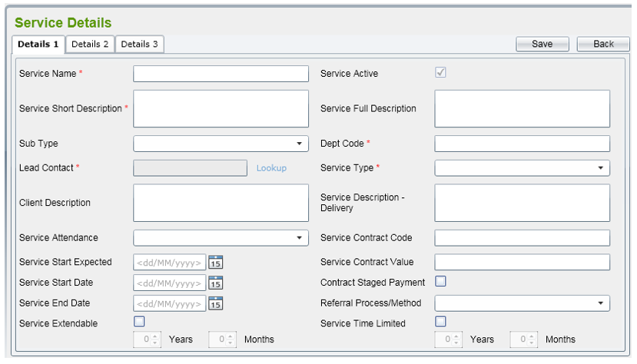
2. Design
Screen
return

Slide 13
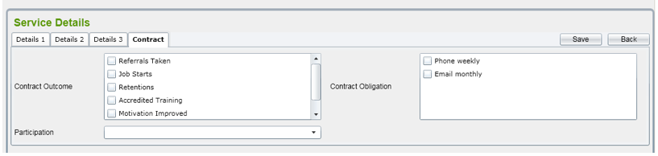
2. Design
Screen

Slide 14
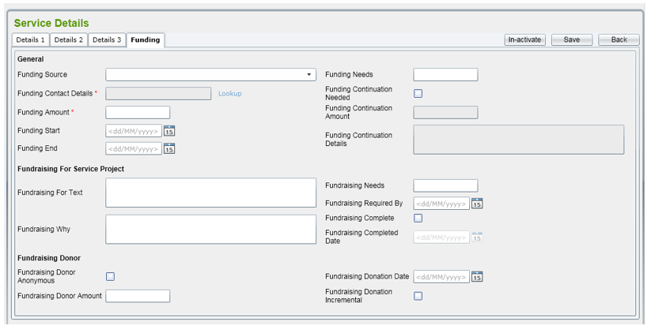
2. Design
Screen

Slide 15
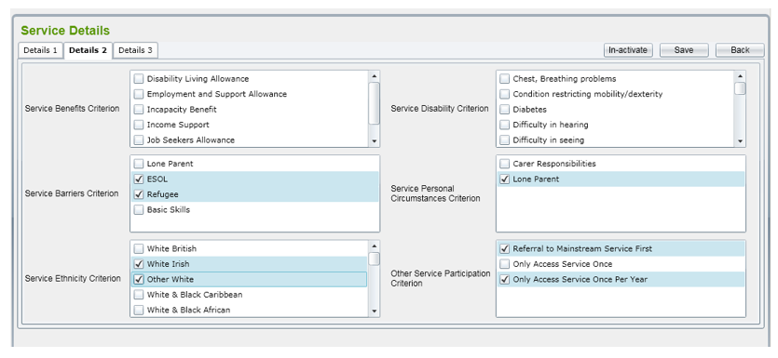
2. Design
Screen
return

Slide 16
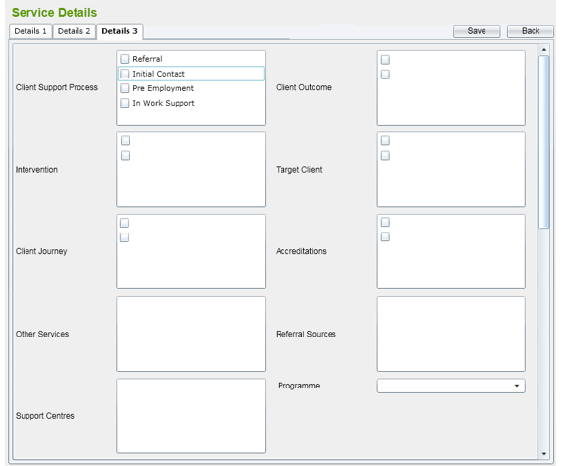
2. Design
Screen

Slide 17
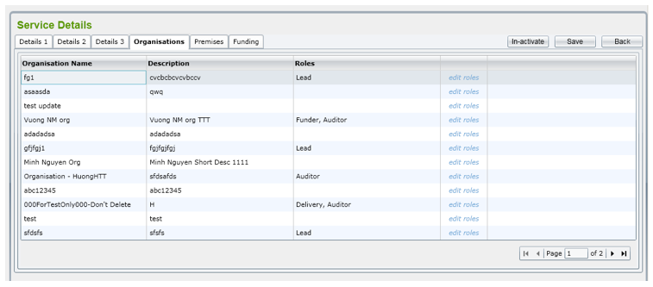
2. Design
Screen
return

Slide 18
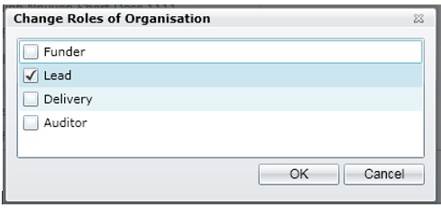
2. Design
Screen

Slide 19
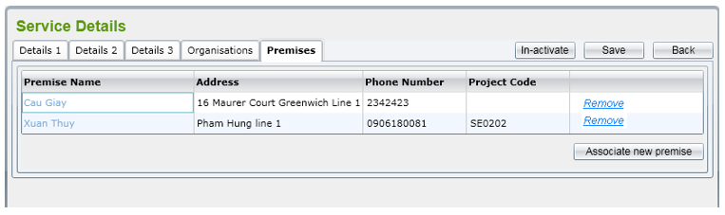
2. Design
Screen

Slide 20
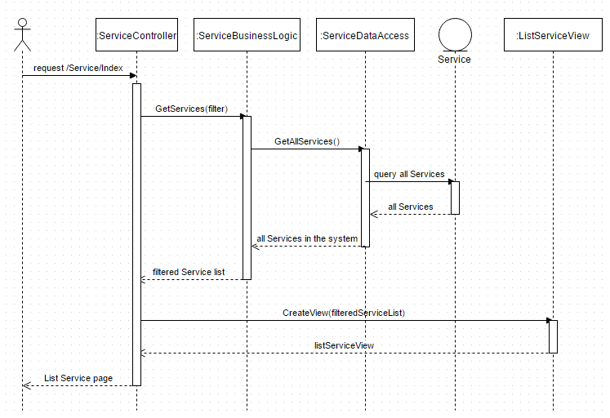
2. Design
Sequence Diagram: List Services

Slide 21
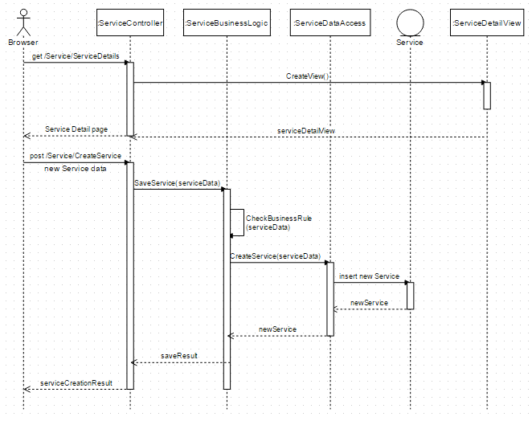
2. Design
Sequence Diagram: Add Service

Slide 22
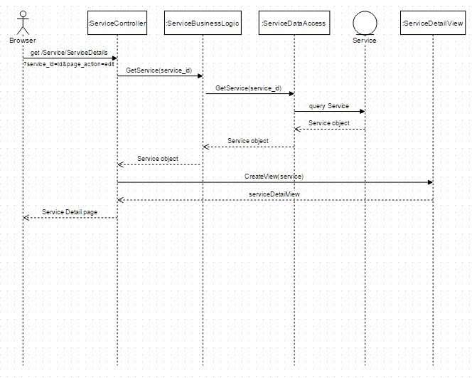
2. Design
Sequence Diagram: Amend Service

Slide 23
2. Design
Database

Slide 24
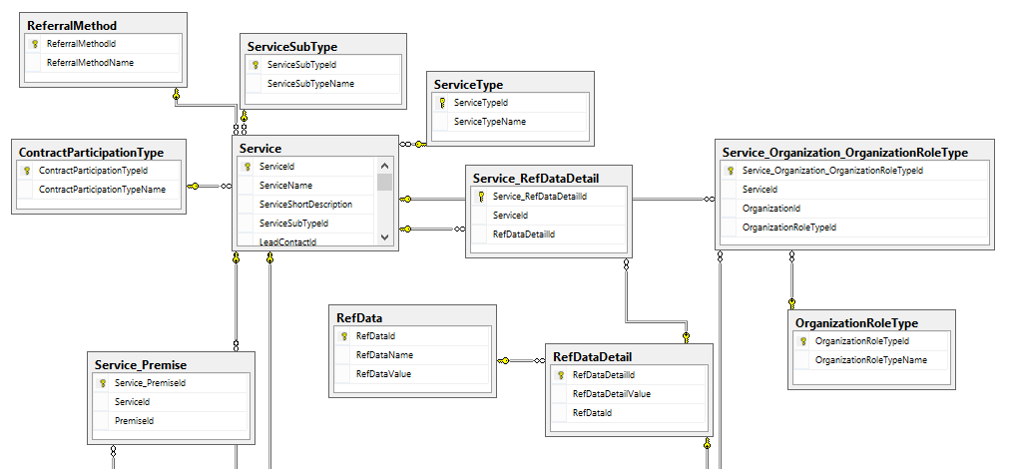
2. Design
Database
Ex.
All of list boxes in this tab get from reference data. Refer to the spreadsheet attached in Reference Data List for more details.

Slide 25
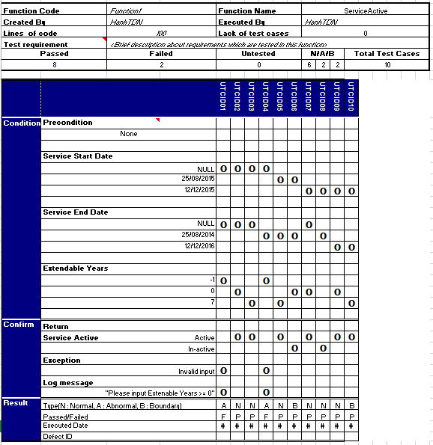
4. Testing

Slide 26
3. Coding
ASP.NET MVC 4
Entity Framework Database First

Slide 27
THANKS FOR YOUR ATTENTION!

